Slide 1

Bank Loan Case Study
By
Stan John Pereira

Slide 2

Project Description
The main aim of this project is to identify patterns that indicate if a customer will have difficulty paying their installments.
This information can be used to make decisions such as denying the loan, reducing the amount of loan, or lending at a higher interest rate to risky applicants.
The company wants to understand the key factors behind loan default so it can make better decisions about loan approval.
As a Data Analyst, my task is to use Exploratory Data Analysis (EDA) to analyze patterns in the data and ensure that capable applicants are not rejected.

Slide 3
Approach
Identify Top Correlations for Different Scenarios
Identify Missing Data and Deal with it Appropriately
Identify Outliers in the Dataset
Analyze Data Imbalance
Perform Univariate, Segmented Univariate, and Bivariate Analysis

Slide 4
Tech Stack Used
Microsoft Excel 2010 Version 14.0.7628.5000
Ability to perform calculations, data analysis, data visualization, data transformation, and data cleaning with Excel tools and functions.
Transform and clean data with features like Power Query and Flash Fill.
Code to automate tasks and customize functions with VBA (Visual Basic for Applications).
Availability of free templates and code to customize and automate Excel.

Slide 5
Insights

Slide 6
Task 1 : Identify Missing Data and Deal with it Appropriately
As a data analyst, you come across missing data in the loan application dataset. It is essential to handle missing data effectively to ensure the accuracy of the analysis.
Understand the Data
Find and Handle Missing Values (Rows and Columns)
Remove Irrelevant Columns
Remove Duplicates
Impute Missing Values with Mean/Median/Mode

Slide 7
Understand the Data
Application Data Table
Provides details about the current loan applications.
Application Data (before Cleaning)
Total Rows | 49999
Total Columns | 122
Columns with Null %age >40% | 49

Slide 8
Find and Handle Missing Values (Rows and Columns)
NO DUPLICATES FOUND – SK_ID_CURR
Columns Dropped as not required for Analysis
EXT_SOURCE2 | EXT_SOURCE3
Columns Dropped due to Blank Percentage over 40%
COMMONAREA_AVG | NONLIVINGAREA_MEDI
COMMONAREA_MEDI | NONLIVINGAREA_MODE
COMMONAREA_MODE | ELEVATORS_AVG
NONLIVINGAPARTMENTS_AVG | ELEVATORS_MEDI
NONLIVINGAPARTMENTS_MEDI | ELEVATORS_MODE
NONLIVINGAPARTMENTS_MODE | WALLSMATERIAL_MODE
LIVINGAPARTMENTS_AVG | APARTMENTS_AVG
LIVINGAPARTMENTS_MEDI | APARTMENTS_MEDI
LIVINGAPARTMENTS_MODE | APARTMENTS_MODE
FONDKAPREMONT_MODE | ENTRANCES_AVG
FLOORSMIN_AVG | ENTRANCES_MEDI
FLOORSMIN_MEDI | ENTRANCES_MODE
FLOORSMIN_MODE | LIVINGAREA_AVG
YEARS_BUILD_AVG | LIVINGAREA_MEDI
YEARS_BUILD_MEDI | LIVINGAREA_MODE
YEARS_BUILD_MODE | HOUSETYPE_MODE
OWN_CAR_AGE | FLOORSMAX_AVG
LANDAREA_AVG | FLOORSMAX_MEDI
LANDAREA_MEDI | FLOORSMAX_MODE
LANDAREA_MODE | YEARS_BEGINEXPLUATATION_AVG
BASEMENTAREA_AVG | YEARS_BEGINEXPLUATATION_MEDI
BASEMENTAREA_MEDI | YEARS_BEGINEXPLUATATION_MODE
BASEMENTAREA_MODE | TOTALAREA_MODE
EXT_SOURCE_1 | EMERGENCYSTATE_MODE
NONLIVINGAREA_AVG
Columns Having Blank Percentage Data Imputed based on Mean/Median/Mode
OCCUPATION_TYPE | Mode Used. New Type assigned as Blank had the most records - ‘Unknown’
AMT_REQ_CREDIT_BUREAU_DAY | Median Used
AMT_REQ_CREDIT_BUREAU_HOUR | Median Used
AMT_REQ_CREDIT_BUREAU_MON | Median Used
AMT_REQ_CREDIT_BUREAU_QRT | Median Used
AMT_REQ_CREDIT_BUREAU_WEEK | Median Used
AMT_REQ_CREDIT_BUREAU_YEAR | Median Used
NAME_TYPE_SUITE | Mode Used. Changed the Blanks to ‘Unaccompanied’
DEF_30_CNT_SOCIAL_CIRCLE | Median Used
DEF_60_CNT_SOCIAL_CIRCLE | Median Used
OBS_30_CNT_SOCIAL_CIRCLE | Median Used
OBS_60_CNT_SOCIAL_CIRCLE | Median Used
AMT_GOODS_PRICE | Median Used
Columns with Minimal Blank Percentage Rows with Blank Values dropped
AMT_ANNUITY | 01 Row Dropped
CNT_FAM_MEMBERS | 01 Row Dropped
DAYS_LAST_PHONE_CHANGE | 01 Row Dropped

Slide 9
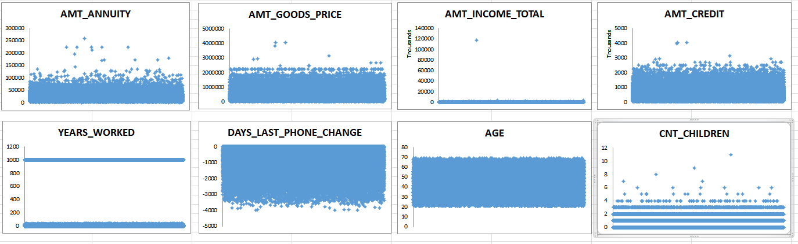
Task 2: Identify Outliers in the Dataset
Outliers can significantly impact the analysis and distort the results. You need to identify outliers in the loan application dataset.

Slide 10
Outliers Analysis
There are few high outliers in AMT_ANNUITY which does not give a very healthy analysis and can skew the mean.
There are a few outliers in AMT_GOODS_PRICE & AMT_CREDIT where the amount is more than normal.
There is an outliers in AMT_INCOME_TOTAL which is extraordinarily high, which is unusual.
The YEARS_WORKED data has quite a lot of data that has the value - 1000 years. This is impossible. On further investigating the data, it was found that the value was assigned for ‘Pensioners’
There are a few outliers in DAYS_LAST_PHONE_CHANGE which suggests that many people are using the same phone for a long time, even over 8 years
Most of the people in the data are over 20 years and below 75 years, which shows that the data is not skewed from the point of age.
Lastly, there are few outliers in CNT_CHILDREN, where a few people have more than 4 children, which is impractical and can put financial pressure.

Slide 11
Task 3 : Analyze Data Imbalance
Data imbalance can affect the accuracy of the analysis, especially for binary classification problems. Understanding the data distribution is crucial for building reliable models.

Slide 12
Data Imbalance
All the charts shown have Data Imbalance
The Pie Charts have RePayers, Females and Cash Loans are majority in the data.
The Bar Charts have people who have studied till Secondary, Married and People staying in Apartments taking up most of the data

Slide 13
Task 4 : Perform Univariate, Segmented Univariate, and Bivariate Analysis
To gain insights into the driving factors of loan default, it is important to conduct various analyses on consumer and loan attributes.
To attain an analysis of the data, we will be performing the below:
Univariate Analysis to understand the distribution of individual variables
Segmented Univariate Analysis to compare variable distributions for different scenarios
Bivariate Analysis to explore relationships between variables and the target variable using Excel functions and features.

Slide 14
Univariate and Segmented Univariate Analysis
Middle Age group have been given the most loans
The percentage of Defaulters decrease as age increases
Most people taking loans have less than 10 years work experience
Defaulters decrease as work experience increase

Slide 15
Univariate and Segmented Univariate Analysis
Most people take Cash Loans
Cash Loans has the highest Defaulter Percentage
Majority of the Applied Loans are by Working Professionals
Highest Defaulters are Unemployed
Students and Businessmen are less likely to default

Slide 16
Univariate and Segmented Univariate Analysis
Most people applying for loans have only had Secondary Education
Lower Education has the highest defaulters
Singles or People with no children are the highest loan appliers
Outliers with over 8 kids are defaulters

Slide 17
Univariate and Segmented Univariate Analysis
Most people applying for loans stay in Apartments
Most Defaulter Percentage stay with their parents or on rent
Majority of the people applying for loans are in the low income group
The High Income Groups are more likely to pay their loans, but the Very High Income Groups have the highest defaulter percentage

Slide 18
Bivariate Analysis
More credit is given to people as they grow older, but once they are reaching their retirement, the credit decreases. This is due to the fact that with age you default less
Businessmen get the highest credit amount whereas Students get the lowest

Slide 19
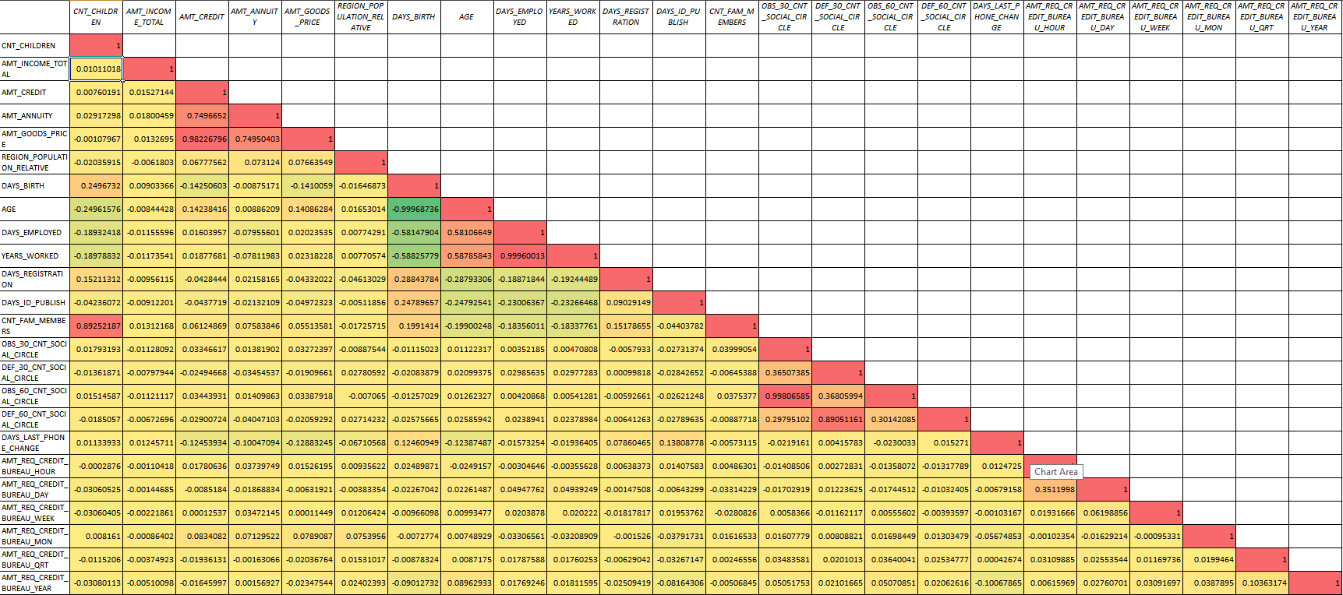
Task 5 : Identify Top Correlations for Different Scenarios
Correlation Matrix for Defaulters

Slide 20
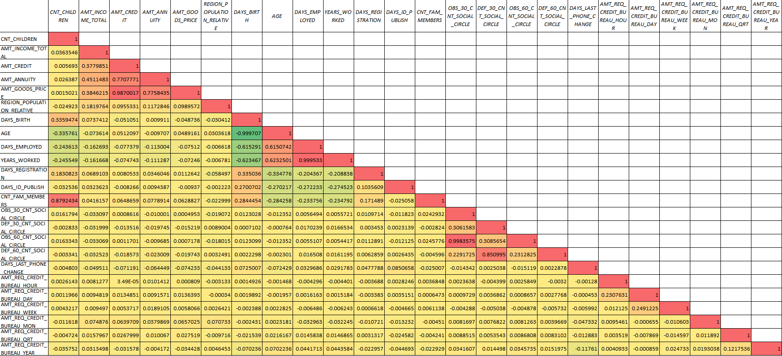
Task 5 : Identify Top Correlations for Different Scenarios
Correlation Matrix for Non-Defaulters

Slide 21
Results

Slide 22
Results
This project involved an extensive use of Excel and Statistics. It was an enormous challenge trying to work in Excel and manipulate such massive data.
Nonetheless, the project was very insightful and informative. It allowed me to learn to work with such datasets.
Throughout the project, I got a deeper understanding on EDA, right from analysing the data columns, to handling missing data and creating new analysis.
I was also able to learn about new add-ins in Excel such as Data Analyzer.
Link to Excel File

Slide 23

THANK YOU

